Slide 1
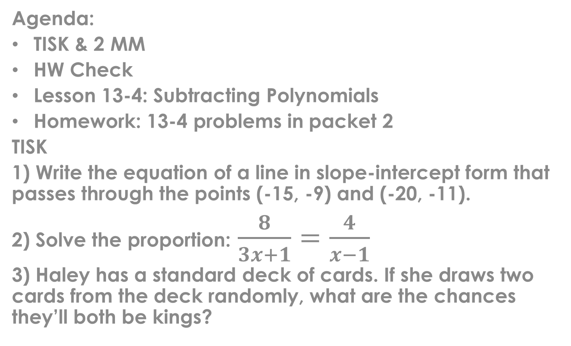
Wednesday, February 13, 2013
Agenda:
TISK & 2 MM
HW Check
Lesson 13-4: Subtracting Polynomials
Homework: 13-4 problems in packet 2
TISK
1) Write the equation of a line in slope-intercept form that passes through the points (-15, -9) and (-20, -11).
2) Solve the proportion: $\frac{8}{3x+1}=\frac{4}{x−1}$
3) Haley has a standard deck of cards. If she draws two cards from the deck randomly, what are the chances they’ll both be kings?
Notes:
Mental Math
1.) Start with the difference of 80 and 29. (51) Divide by 3. (17) Add the result of 5 squared. (42) Divide by 7. (6) Write your answer.
Check: Raise your hand if you got a number less than 10. Less than 100. Show the one’s digit of your answer. Show the ten’s digit.
2.) Start with the quotient of 522 and 3. (174) Subtract 89. (85) Divide by 5. (17) Add 29. (46) Divide by 2. (23) Write your answer.
Check: Raise your hand if you got a number greater than 10. Greater than 100. Show the one’s digit of your answer. Show the ten’s digit.

Slide 2
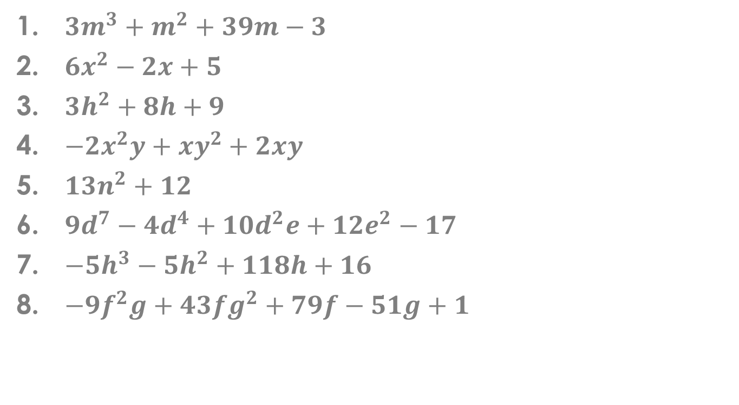
Homework Check
$3m^{3}+m^{2}+39m−3$
$6x^{2}−2x+5$
$3h^{2}+8h+9$
$−2x^{2}y+xy^{2}+2xy$
$13n^{2}+12$
$9d^{7}−4d^{4}+10d^{2}e+12e^{2}−17$
$−5h^{3}−5h^{2}+118h+16$
$−9f^{2}g+43fg^{2}+79f−51g+1$

Slide 3
§13-4 Subtracting Polynomials
When you subtract polynomials you must add the opposite first, then collect like terms.

Slide 4
Your Turn!

Slide 5
Try another!

Slide 6
One more!

Slide 7
Tomorrow
Your test tomorrow will cover lessons 12-1 through 12-7. Use your Quizzes as study guides!
Tonight, you may choose to spend time studying for the test, then complete the homework for tonight tomorrow night instead.
Make sure to review the daily TISK problems so that you’re prepared for the Review section of your test.

